Slide 1

Flutter

Slide 2
Flutter
Application Life Cycle
Widget
StatelessWidgets
StatefulWidgets

Slide 3
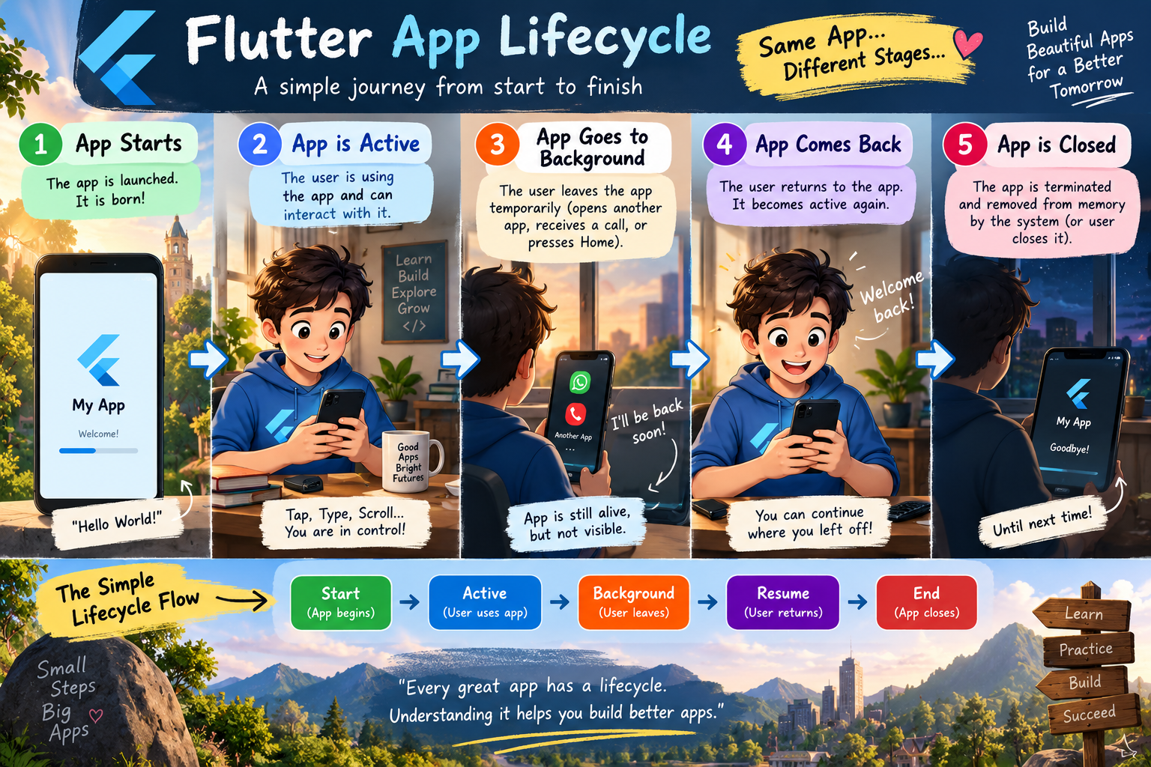
App Life Cycle

Slide 4
What is a Widget?
Key Points
• A widget describes part of the user interface.
• Text, images, buttons, layout containers and screens are built from widgets.
• Widgets can be combined to create complex interfaces.
• Think of a widget as a reusable UI building block.
• Flutter UI is constructed by composing widgets.

Slide 5
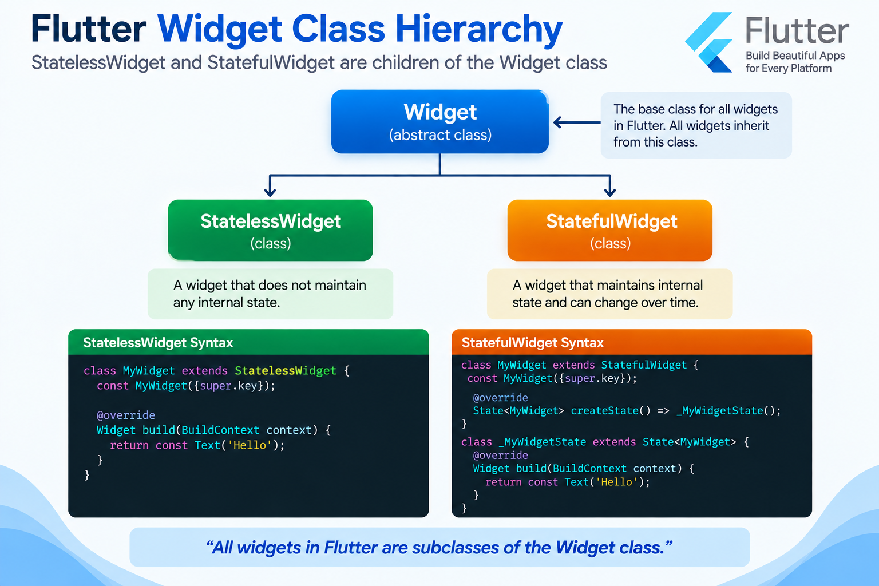
Flutter Widget Hierarchy

Slide 6
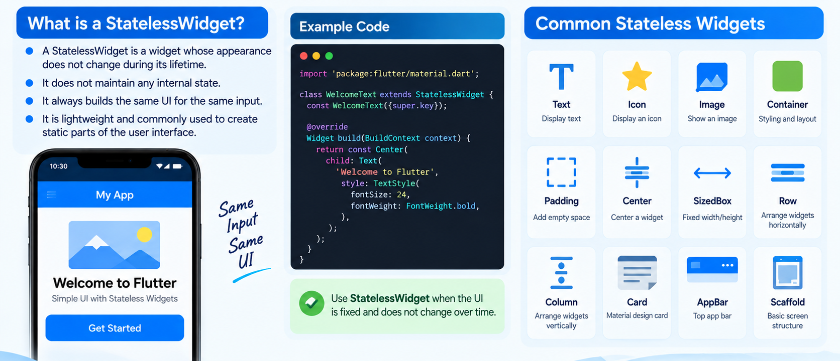
Stateless Widgets

Slide 7
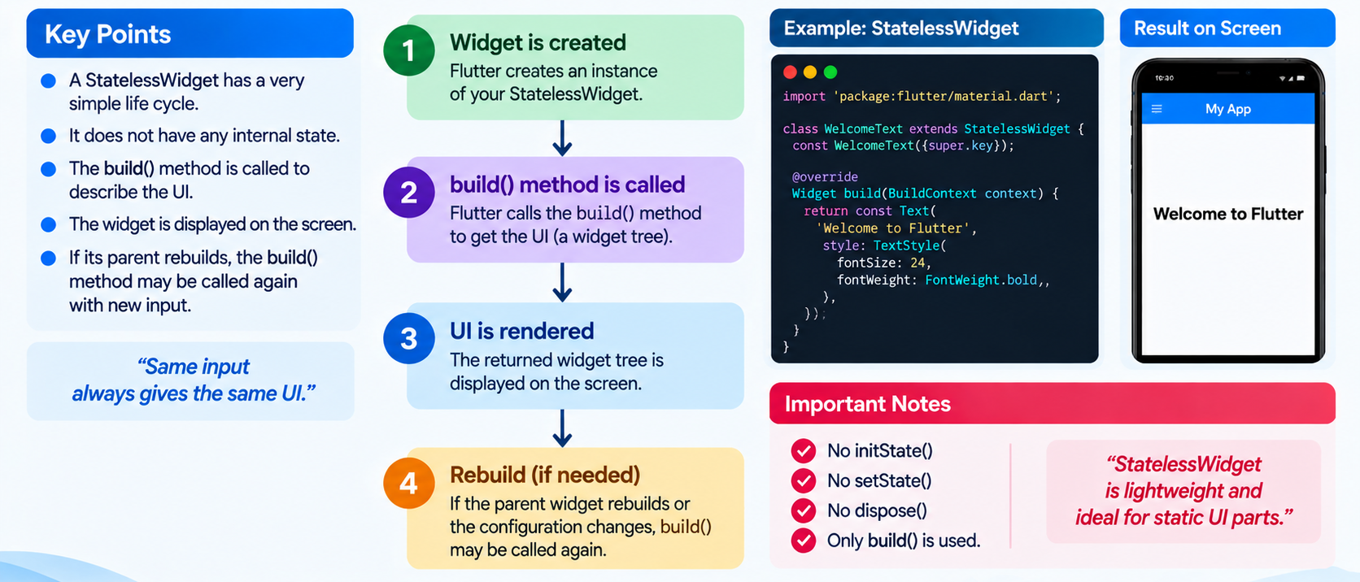
Life Cycle of Stateless Widget

Slide 8
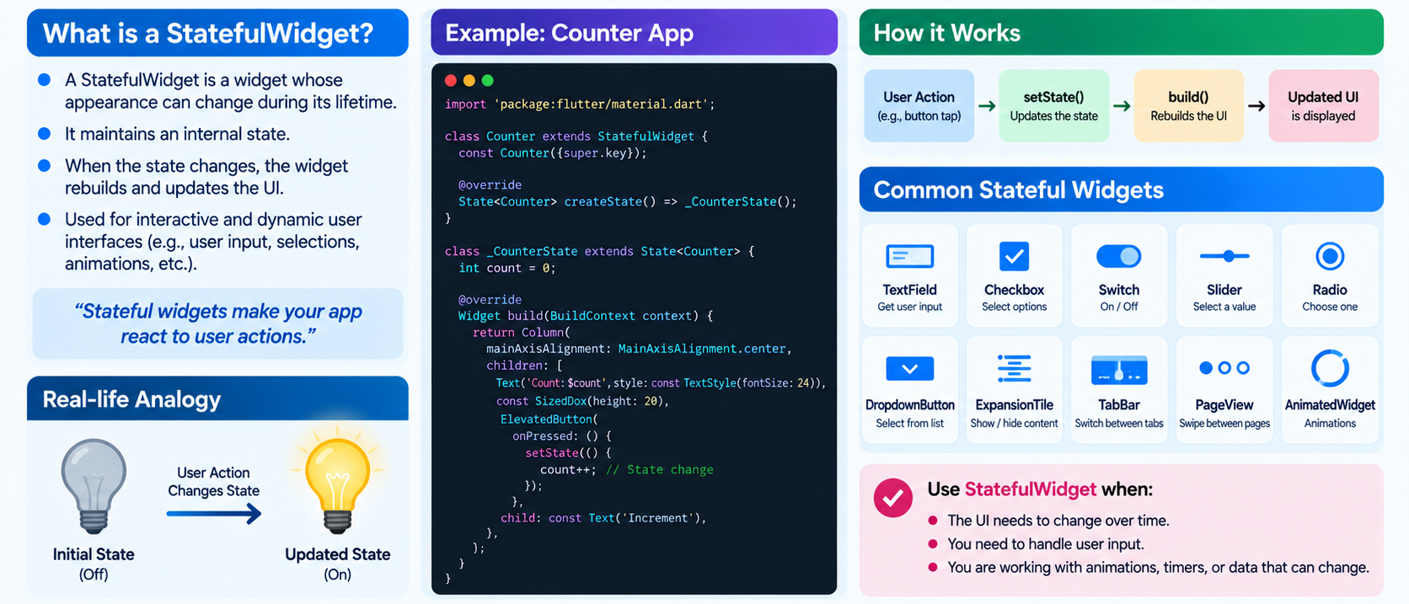
StatefulWidgets

Slide 9
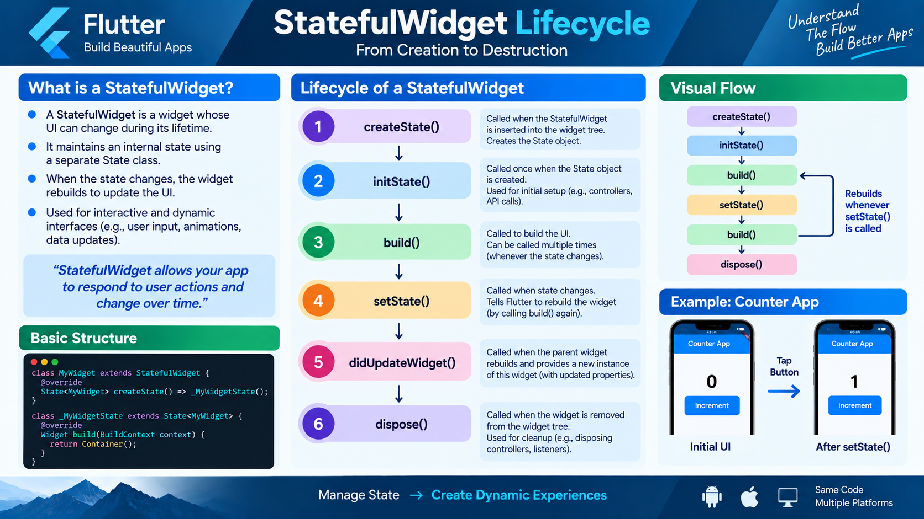
StatefulWidget & Lifecycle

Slide 10
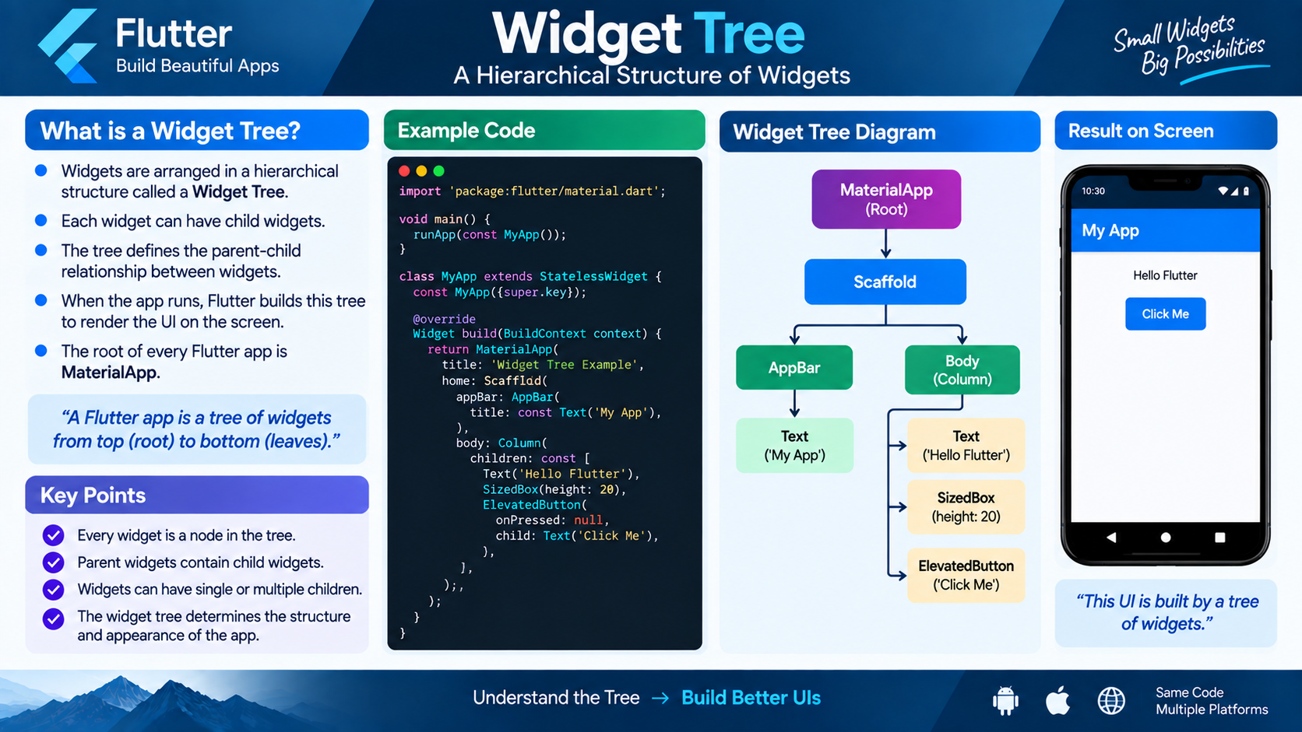
Widget Tree
Parent → Child → Grandchild

Slide 11
Stateless vs Stateful
StatelessWidget
StatefulWidget
Remember
• No mutable internal state
• Simple and lightweight
• Good for static/presentation UI
• Example: Text, Icon, Image
• UI depends on configuration/inputs
Remember
• Maintains changing state
• Has a separate State object
• Good for interactive/dynamic UI
• Example: Switch, TextField, Checkbox
• setState() can trigger a rebuild
Rule of thumb: If the UI needs to remember and react to changing data, think Stateful.

Slide 12
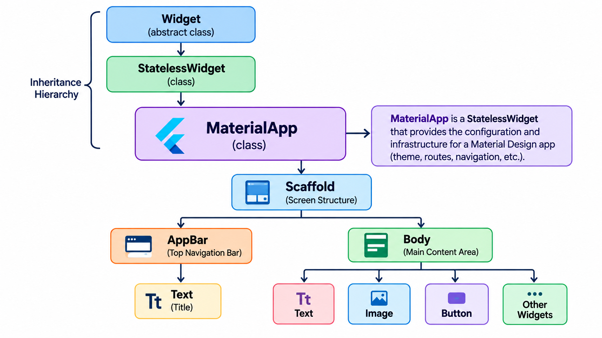
Basic App Hierarchy

